Slide 1
Emergency Department Wait Time Prediction: Systematic Literature Review
Presented by:
Vandan Patel - Team Lead Annagrace Howell - Developer Yasmin Rocio Orduz Landazabal - Data Analyst
Instructor:
Ph.D. Vijayalakshmi Ramasamy CSCI-7090-A-O1E
Data Science & Machine Learning
Georgia Southern University
Notes:
Vandan

Slide 2

Introduction to Literature Review
Why emergency department (ED) wait time prediction has become an operational machine learning problem
Problem background
Core logic across the literature
All reviewed studies use the same modeling principle: combine patient severity with system pressure information
EDs worldwide face severe overcrowding and growing wait times. Prolonged wait times worsen patient outcomes, increase mortality, reduce staff efficiency, and drive patients to leave without being seen.
ML methods leverage triage variables, patient demographics, and hospital operational data to estimate wait time and optimize patient flow.
Predictive systems matter because hospitals can use early forecasts to optimize staffing, improve patient routing, and reduce crowding before queues worsen.
Common variables
Triage level (ESI/MTS)
Differs
Patient demographics
Prediction of the outcome
Arrival time & patterns
Data source / hospital
ED workload & crowding
Same operational goal
Queue status
Service-flow measures
Team 3 - Georgia Southern University - CSCI 7090 - 2026
Notes:
vandan

Slide 3
Research Question and Themes
The literature review organizes the project around one prediction objective and four recurring themes
Wait time prediction
Supervised models estimate wait time or prolonged wait from triage and queue variables.
Binary & Regression Targets
Most recurrent predictors
Research Question: How can supervised ML algorithms trained on routinely collected ED triage data accurately predict patient wait times, and what methodological approaches produce the most clinically interpretable and generalizable models?
1
Triage level
Patient demographics
Arrival time and temporal patterns
AI-based triage
Text-based and triage-based models enrich early patient assessment.
NLP + Structured Data
2
Current emergency departments workload
Queue and service-flow variables
Why the question matters
ED wait time is not only a patient experience metric. ED wait time is also a queue-management signal that affects crowding, throughput, staffing, and timelines of care. A useful model therefore needs both patient-level features and system-level features.
Interpretation: The literature constantly treats waiting time as a joint function of patient severity and operational congestion- both dimensions are needed for useful prediction
Resource optimization
Forecast support staffing, room assignment, and congestion response.
Operational Decision Support
3
Real-time forecasting
The hardest challenge is producing predictions useful during live operations.
Deployment Challenge
4
Team 3 - Georgia Southern University - CSCI 7090 - 2026
Notes:
vandan

Slide 4
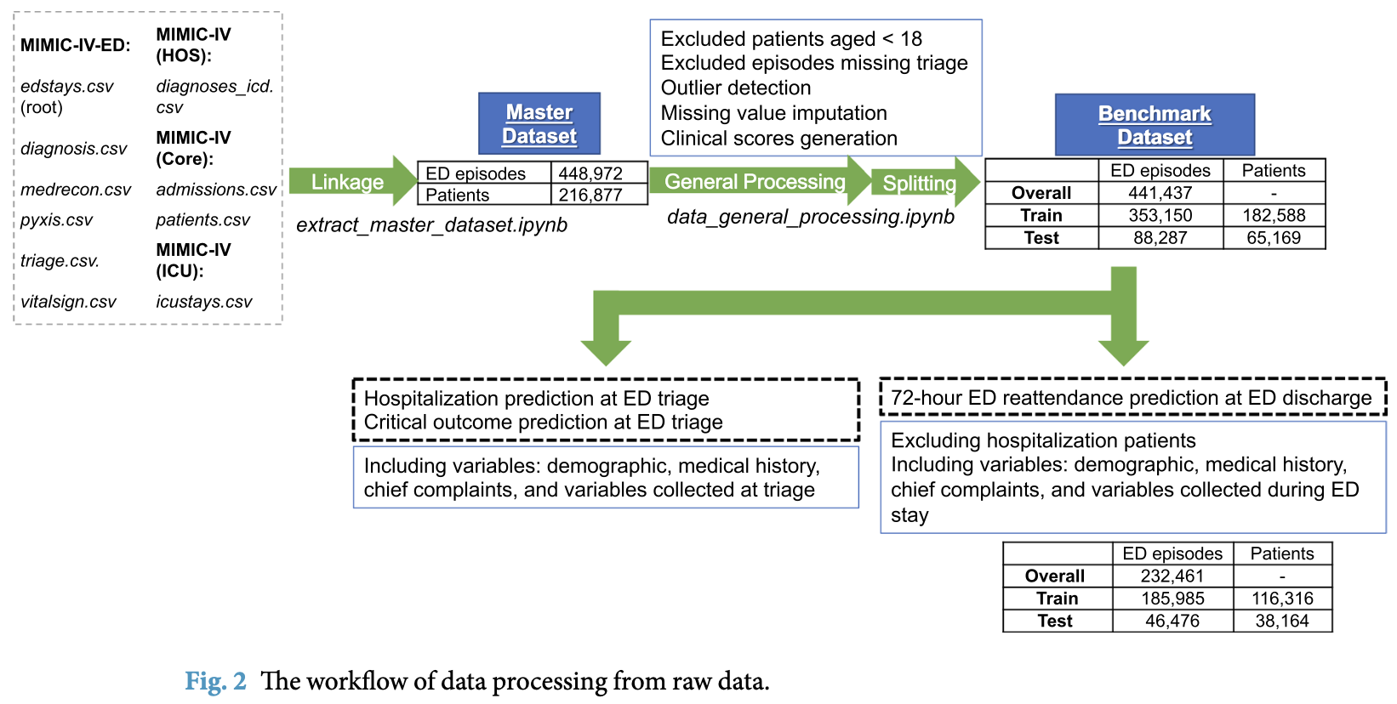
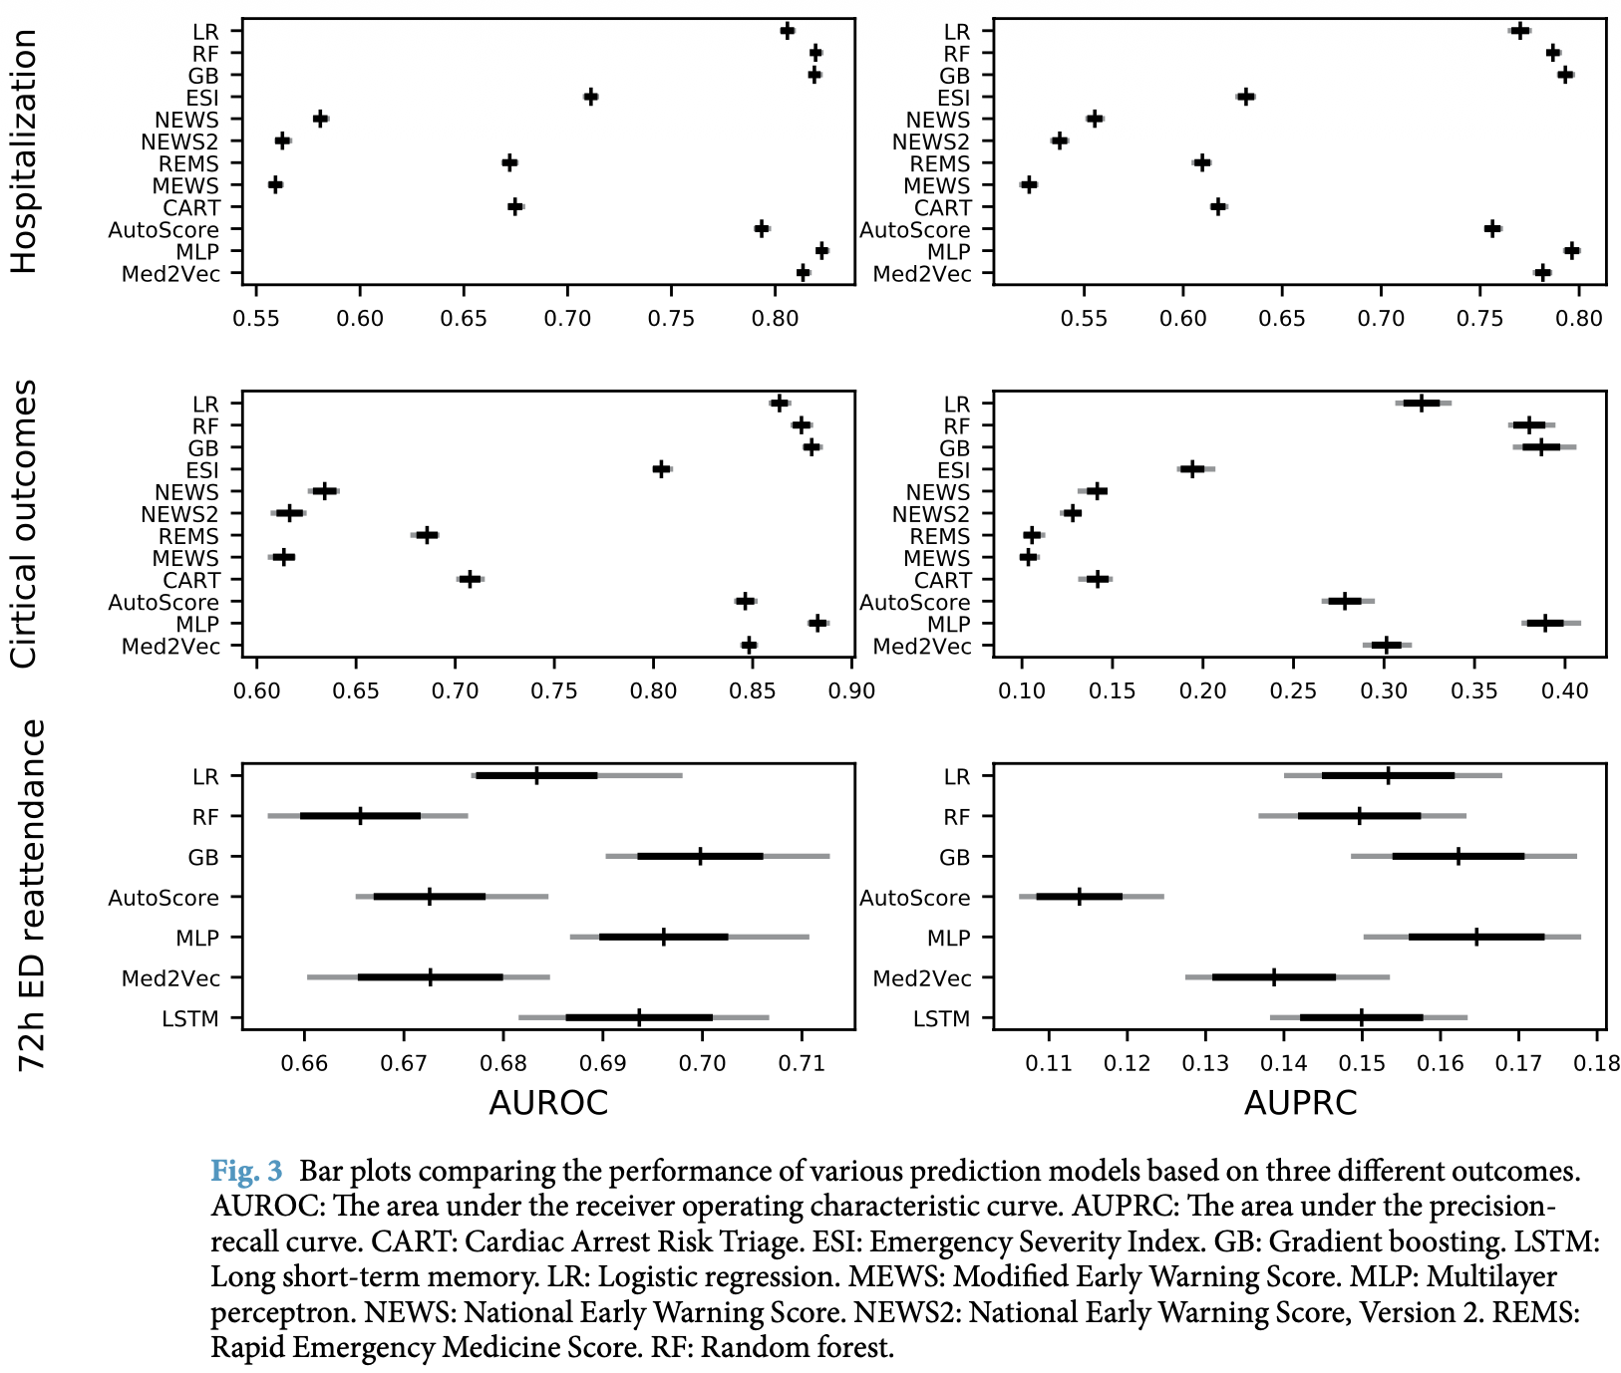
Paper 4: Benchmarking Emergency Department Predictions
Research focus
First open-source ED prediction benchmark using the publicly available MIMIC-IV-ED dataset, enabling reproducible comparisons across models and institutions.
Methodology
Dataset: MIMIC-IV-ED: (~448k visits, 2011-2019).
Models: LR, RF, Gradient Boosting, MPL Med2Vec, LSTM, Autoscore.
Features: Triage vitals, ESI level, demographics, ICD comorbidities.
Tasks: hospitalization, critical outcomes (ICU/mortality), 72-hr reattendance.
Key findings
Gradient Boosting achieved AUROC 0.880 for critical outcomes. RF & GB outperformed all clinical scoring systems (MEWS, NEWS, REMS, CART). Deep learning showed only marginal improvement over classical ML with low-dimensional ED data. AutoScore balanced interpretability and accuracy.
Strengths
First large-scale public ED benchmark (400+ visits).
Open-source pipeline on GitHub (reproducible).
Published in Nature Scientific Data.
Enables model-to-model comparison across studies.
Limitations
Does not address wait time prediction directly.
Single institution (Beth israel Deaconess, Boston).
No SHAP or interpretability analysis.
No ESI triage-level segmentation or fairness analysis.
Single institution.
Xie, F., Zhou, J., Lee, J. W., et al. (2022)
Why the paper matters for our project: Uses our exact dataset (MIMIC-IV-ED) and provides the open-source preprocessing pipeline we build on. Baseline model AUROCs serve as direct benchmarks. We add continuous wait time regression with SHAP and ESI subgroup analysis as a fourth prediction task.
Team 3 - Georgia Southern University - CSCI 7090 - 2026
Xie, F., et al. (2022). Benchmarking emergency department prediction models with machine learning and public electronic health records. Scientific Data, 9, 658. https://doi.org/10.1038/s41597-022-01782-9
Notes:
yasmin

Slide 5
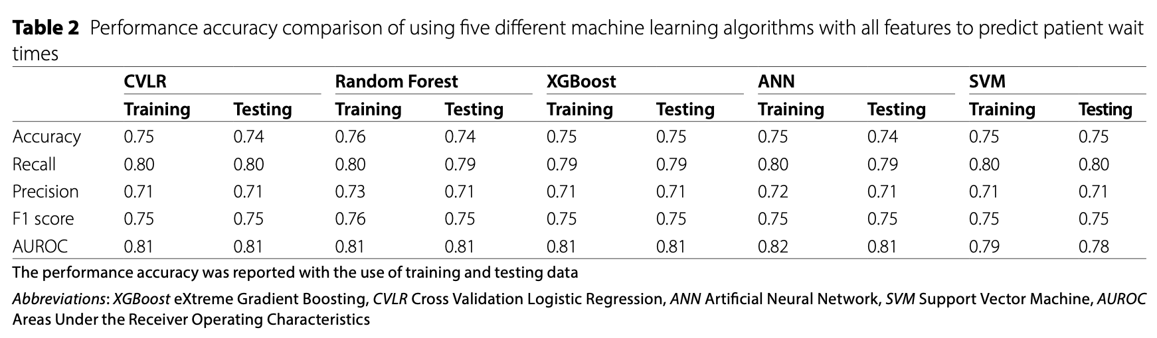
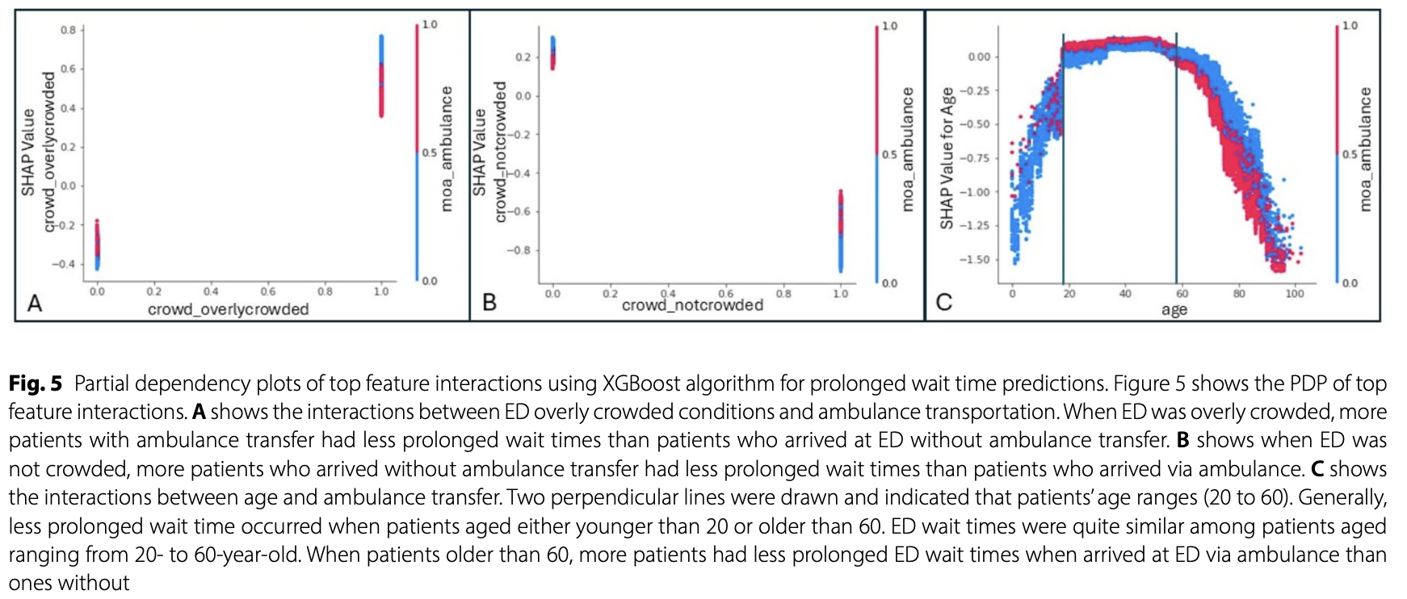
Paper 7: Interpretable Machine Learning Models for Prolonged Emergency Department Wait Time Prediction
Research focus
Comprehensive analysis of ML models to predict prolonged ED wait time (≥30 min) in ESI-3 patients, with global and local SHAP interpretation of key features and feature interactions.
Methodology
Dataset: 177,665 ESI-3 visits, Fort Worth TX (Jan 2019 - Dec 2021).
Models: CVLR, Random Forest, XGBoost, ANN, SVM (70/30 split, 5-fold cv).
Target: binary - prolonged wait time (≥30 min vs <30 min.
Metrics: Accuracy, recall, precision, F1, AUROC, FRP, FNR. SHAP beeswarm + PDP used for interpretation).
Key findings
~48% of patients prolonged wait time. All five models showed comparable accuracy (~0.75). Minimizing FNR was most clinically relevant. Top predictors: ED crowding status and mode of arrival (ambulance). Female patients and Hispanic/Latino patients had higher prolonged wait times.
Strengths
Only study comparing 5 ML algorithms specially for ED wait time.
SHAP beeswarm + PDP + feature interaction analysis.
Large real-world single-center dataset (177K+ visits).
Clinical framing: FNR prioritized over FPR.
Limitations
Binary classification only - no continuous wait time regression.
ESI-3 patients only - not generalizable to all triage levels.
Single-center study; limited external validity.
No formal demographic fairness mitigation proposed.
Wang, H., Sambamoorthi, N., Sandlin, D., and Sambamoorthi, U. (2025)
Why the paper matters for our project: Directly mirrors our use case with same prediction target (ED wait time), same model family (XGBoost, RF, and same interpretability tool (SHAP). Provides a direct methodological template and performance baseline. We extended to continuous regression, all 5 ESI levels, and MIMIC-IV-EDfor full reproducibility.
Team 3 - Georgia Southern University - CSCI 7090 - 2026
Wang, H., Sambamoorthi, N., Sandlin, D., & Sambamoorthi, U. (2025). Interpretable machine learning models for prolonged emergency department wait time prediction. BMC Health Services Research, 25, 403. https://doi.org/10.1186/s12913-025-12535-w
Notes:
yasmin

Slide 6
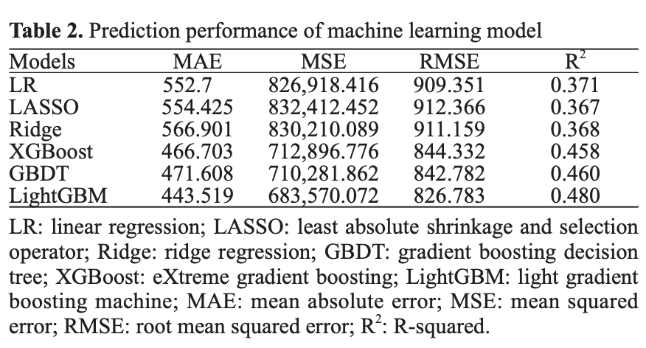
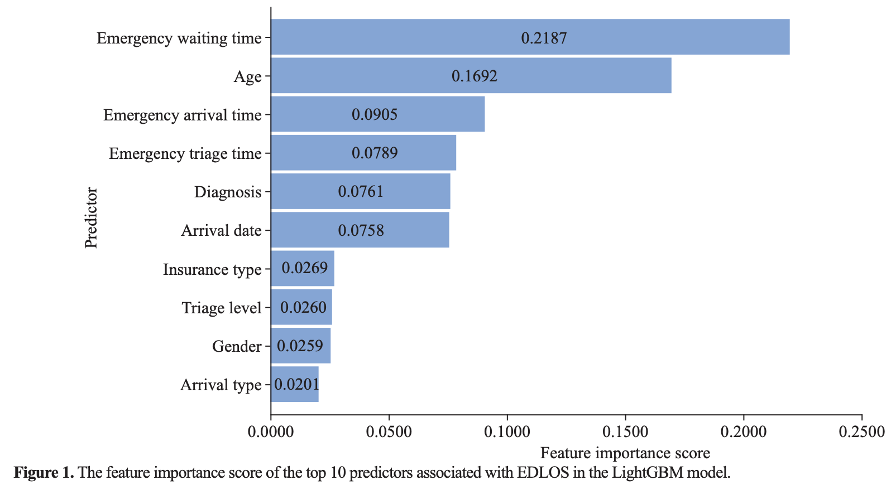
Paper 9: Development of an Emergency Department Length-of-Stay Prediction Model Based on Machine Learning
Research focus
Develop and compare ML regression models to predict continuous Emergency Department length of Stay (EDLOS) in minutes, identifying the most accurate algorithm and key predictive factors.
Methodology
Dataset: 187,028 adult ED visits, Guangzhou Medical University (Mar 2019 - Sep 2021).
Models: LR, LASSO, Ridge, GBDT, XGBoost, LightGBM.
Target: Continuous EDLOS (minutes).
Evaluation: MAE, MSE, RMSE, R-squared (cross-validated; 70/30 split). Feature importance via LightGBM.
Key findings
LightGBM achieved the best performance: MAE = 443.5, RMSE 826.8, R-squared = 0.48 - significantly outperforming linear baseline (R-squared = 0.37). Top 3 predictors: emergency wait time (feature importance 0.219), age (0.169), emergency arrival time (0.091) Triage level, diagnosis, and arrival date also ranked in top 10.
Strengths
One of few ED using continuous regression (minutes) rather than binary classification..
Large real-world dataset (187K cases).
Directly validates LightGBM and XGBoost as strong regression baselines for EDLOS.
Clear LightGBM feature importance ranking provided.
Limitations
Single-center, single-country study - limited generalizability.
No SHAP for patient-level interpretation.
No ESI triage-level subgroup analysis.
No fairness or demographic disparity analysis.
Excludes unstructured EHR Text (chief complaint, history).
Wu, W., Li, M., Jiang, H., Sun, M., Zhu, Y., Zhu, G., Li, Y., Li, Y., Mo, J., Chen, X., and Mao, H. (2025)
Why the paper matters for our project: Validates the regression approach and confirms lightGBM/XGBoost as strong baselines for continuous EDLOS prediction. We replicate this regression framework on the public MIMIC-IV-ED dataset and extend it with SHAP interpretability, ESI-level segmentation, and a fairness assessment - addressing all four gaps identified in this study.
Wu, W., Li, M., Jiang, H., Sun, M., Zhu, Y., Zhu, G., Li, Y., Li, Y., Mo, J., Chen, X., & Mao, H. (2025). Development of an emergency department length-of-stay prediction model based on machine learning. World Journal of Emergency Medicine, 16(3), 220–224. https://doi.org/10.5847/wjem.j.1920-8642.2025.048
Team 3 - Georgia Southern University - CSCI 7090 - 2026
Notes:
Annagrace

Slide 7
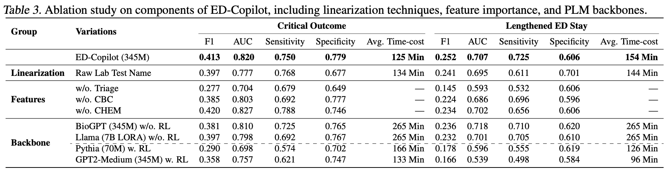
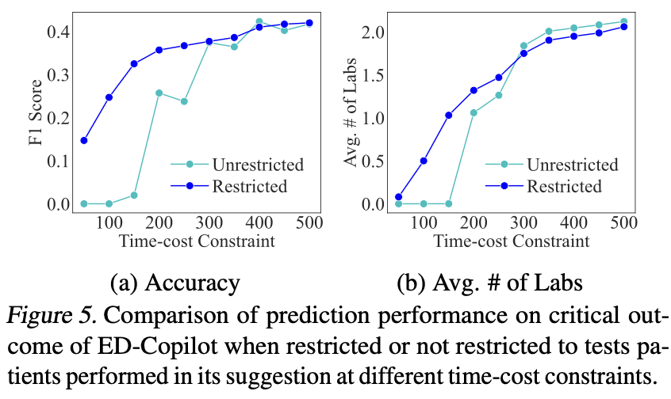
Paper 12: ED-Copilot: Reduce Emergency Department Wait Time Language Model Diagnostic Assistance
Research focus
Can a biomedical LLM combined with RL agent recommend sequential lab tests to reduce ED wait time while maintaining diagnostic accuracy? The only paper shifting from prediction to active clinical decision support.
Methodology
Dataset: MIMIC-ED-Assist (from MIMIC-IV-ED), - 32,356 hospitalized ED visits; 12 lab groups, 68 tests.
Model: BioGPT(345M params) + PPO reinforcement learning agent for sequential lab test selection.
Targets: Critical outcome (death/ICU transfer in 12h) and LOS >24h.
Key findings
ED-Copilot halved average laboratory wait time from ~4 hours to ~2 hours while outperforming all tabular ML baselines. F1 for critical outcome: 0.413 (vs 0.394 best baseline). AUROC: 0.820. Personalized recommendations improved outcomes especially for high -severity (rare lab) patients. Bio-medical pre-training and RL were both necessary for strong performance.
Strengths
Only paper applying LLM + RL for active ED lab ordering optimization.
Published at ICML 2024 (top-tier ML venue).
Uses MIMIC-IV-ED - same data source as our project.
Demonstrates personalized, patient-specific recommendations.
Limitations
Dataset biased to hospitalized patients only - not representative of full ED population.
Binary prediction targets only - no continuous wait time regression.
Computationally expensive (345M-parameters model + RL)..
Single-center (Beth Israel Deaconess); no fairness or demographic analysis.
Offline retrospective benchmark - no real-world clinical validation.
Sun, L., Agarwal, A., Kornblith, A., Yu, B., and Xiong, C. (2024)
Why the paper matters for our project: Demonstrates that reducing lab-ordering time is a meaningful lever for reducing ED LOS. We apply a simpler, interpretable continuous regression approach from triage data alone, adding all ESI levels, SHAP interpretability, and fairness analysis - with far lower computational cost.
Sun, L., Agarwal, A., Kornblith, A., Yu, B., & Xiong, C. (2024). ED-Copilot: Reduce emergency department wait time with language model diagnostic assistance. In Proceedings of the 41st International Conference on Machine Learning(Vol. 235, pp. 46942–46956). PMLR. https://proceedings.mlr.press/v235/sun24a.html
Team 3 - Georgia Southern University - CSCI 7090 - 2026
Notes:
Annagrace

Slide 8

Research Gaps Identified
The literature shows progress, but the literature also leaves several unsolved implementation problems
Limited Continuous Regression
Most studies use binary classification (prolonged vs. not) Only articles 9 and 10 use continuous targets, No study applies regression specifically to ED wait time prediction.
No Triage-Level Segmentation
No study reposts model performance broken down by ESI levels 1-5 separately. ESI-1 and ESI-4 patients have fundamentally different wait time dynamics.
Limited SHAP Interpretability
Only 2 of 10 empirical studies (articles 3 and 7) use SHAP. Article 8 uses TE2Rules as an alternative. Most studies report only global feature importance or none at all.
Proprietary Datasets
7 of 10 empirical studies studies use private single-center hospital data. Only articles 4, 11, and 12 use MIMIC-IV-ED (public), limiting reproducibility and cross-institutional comparison.
Incomplete Fairness Evaluation
Only article 3 and 11 address fairness - article 3 identifies disparities but proposes no mitigation; article 11 test debiasing strategies but focuses on admission, not wait time.
Retrospective Models Only
Most models are retrospective research artifacts rather than live operational tools. Real-time deployment challenges remain largely unaddressed in the literature.
These gaps directly motivate our project: Regression-based ML + SHAP + ESI segmentation +fairness on public MIMIC-IV-ED data
Team 3 - Georgia Southern University - CSCI 7090 - 2026
Notes:
yasmin

Slide 9

How Our Projects Build Upon Existing Work
Proposed approach
Input data.
Patient demographics.
Triage level.
Arrival time.
Emergency department workload
Models:
Random Forest.
Gradient Boosting.
XGBoost.
Project contribution vs Literature
Continuous regression (minutes) - not binary classification.
All 5 ESI triage levels - not just ESI-3.
SHAP at patient + population level
Public MIMIC-IV-ED - fully reproducible.
Formal fairness assessment across demographics.
The literature shows progress, but the literature also leaves several unsolved implementation problems
ED triage data collection (MIMIC-IV-ED)
Research questions and preliminary expectation
Research question 1: Which combination of patient variables and operational variables best predicts wait time?
Research question 2: Which model balances predictive performance and interpretability most effectively?
Preliminary expectation: Ensemble models will perform strongly, but operational usefulness will depend on feature transparency and live deployment feasibility.
Data cleaning & feature engineering
Model training (XGBoost, RF, Gradient Boosting)
Model evaluation (MAE, RMSE, R-squared)
SHAP-based feature importance analysis
ESI-level subgroup & fairness analysis
Team 3 - Georgia Southern University - CSCI 7090 - 2026
Notes:
annagrace

Slide 10
Summary & Conclusion
Key insights
ED overcrowding remains a major global healthcare challenge affecting patient outcomes and staff efficiency.
ML models - especially gradient boosting (XGBoost, LightGBM, RF) - consistently outperform traditional clinical scoring systems.
Combining patient-level features (triage, demographics) with system-level features (crowding, arrival mode) improves prediction.
Real-time deployment, interpretability, and cross-hospital validation remain the most under-addressed gaps in the field.
The MIMIC-IV-ED public dataset has emerged as the reproducibility gold standard for ED prediction research
What the literature establishes and what the project will do next
Our project contribution
Next steps
Dataset collection
Data cleaning and feature engineering
Model training and evaluation
Comparison of Random Forest, Gradient Boosting, and XGBoost
Interpretation of feature importance and operational usefulness
Build a predictive ML model for ED wait time.
1
Use patient data and hospital operational data together.
2
Support better resource allocation and operational decision-making.
3
4
Apply SHAP analysis to identify key features driving wait time predictions.
5
Assess model fairness across ESI triage levels and patient demographic subgroups.
Team 3 - Georgia Southern University - CSCI 7090 - 2026
Notes:
Vandan

Slide 11
References (APA Format)
Porto, B. M. (2024). Improving triage performance in emergency departments using machine learning and natural language processing: A systematic review. BMC Emergency Medicine, 24(1), 219. https://doi.org/10.1186/s12873-024-01135-2
Predicting inpatient admissions from emergency department triage using machine learning: A systematic review. (2025). JACEP Open. https://doi.org/10.1016/j.acepjo.2025.100000
Wang, et al. (2025). Evaluating fairness of machine learning prediction of prolonged wait times in emergency department with interpretable eXtreme gradient boosting. PLOS Digital Health, 4(3). https://doi.org/10.1371/journal.pdig.0000751
Xie, F., et al. (2022). Benchmarking emergency department prediction models with machine learning and public electronic health records. Scientific Data, 9, 658. https://doi.org/10.1038/s41597-022-01782-9
Ricciardi, C., et al. (2024). Evaluation of different machine learning algorithms for predicting the length of stay in the emergency departments: A single-centre study. Frontiers in Digital Health, 5, 1323849. https://doi.org/10.3389/fdgth.2023.1323849
Seo, H., Ahn, I., Gwon, H., et al. (2024). Prediction of hospitalization and waiting time within 24 hours of emergency department patients with unstructured text data. Health Care Management Science, 27, 114–129. https://doi.org/10.1007/s10729-023-09660-5
Wang, H., Sambamoorthi, N., Sandlin, D., & Sambamoorthi, U. (2025). Interpretable machine learning models for prolonged emergency department wait time prediction. BMC Health Services Research, 25, 403. https://doi.org/10.1186/s12913-025-12535-w
Sulaiman, W. A., et al. (2025). Leveraging machine learning and rule extraction for enhanced transparency in emergency department length of stay prediction. Frontiers in Digital Health, 6, 1498939. https://doi.org/10.3389/fdgth.2024.1498939
Wu, W., Li, M., Jiang, H., Sun, M., Zhu, Y., Zhu, G., Li, Y., Li, Y., Mo, J., Chen, X., & Mao, H. (2025). Development of an emergency department length-of-stay prediction model based on machine learning. World Journal of Emergency Medicine, 16(3), 220–224. https://doi.org/10.5847/wjem.j.1920-8642.2025.048
Vural, O., et al. (2025). An artificial intelligence–based framework for predicting emergency department overcrowding: Development and evaluation study. JMIR Medical Informatics, 13, e73960. https://doi.org/10.2196/73960
Lett, E., Shahbandegan, S., Barak-Corren, Y., Fine, A. M., & La Cava, W. G. (2025). Intersectional and marginal debiasing in prediction models for emergency admissions. JAMA Network Open, 8(5), e2512947. https://doi.org/10.1001/jamanetworkopen.2025.12947
Sun, L., Agarwal, A., Kornblith, A., Yu, B., & Xiong, C. (2024). ED-Copilot: Reduce emergency department wait time with language model diagnostic assistance. In Proceedings of the 41st International Conference on Machine Learning(Vol. 235, pp. 46942–46956). PMLR. https://proceedings.mlr.press/v235/sun24a.html

